Slide 1
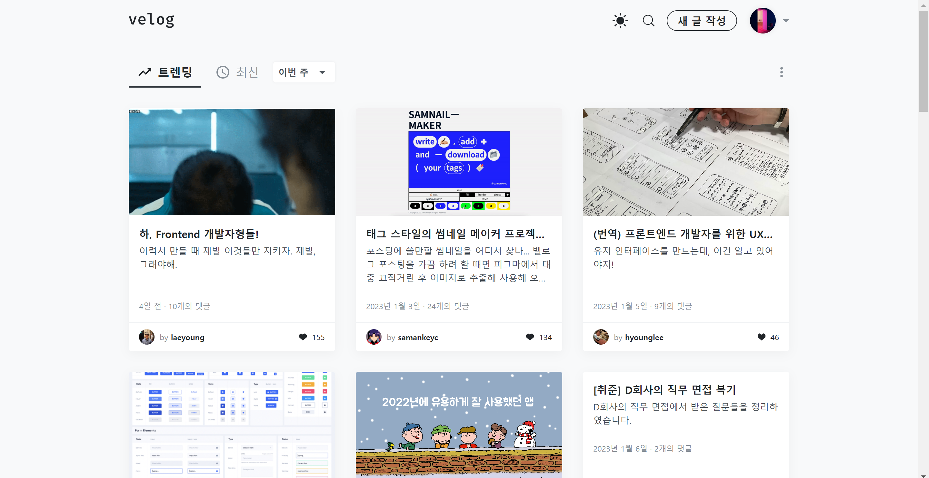
LOGO
user1

Slide 2
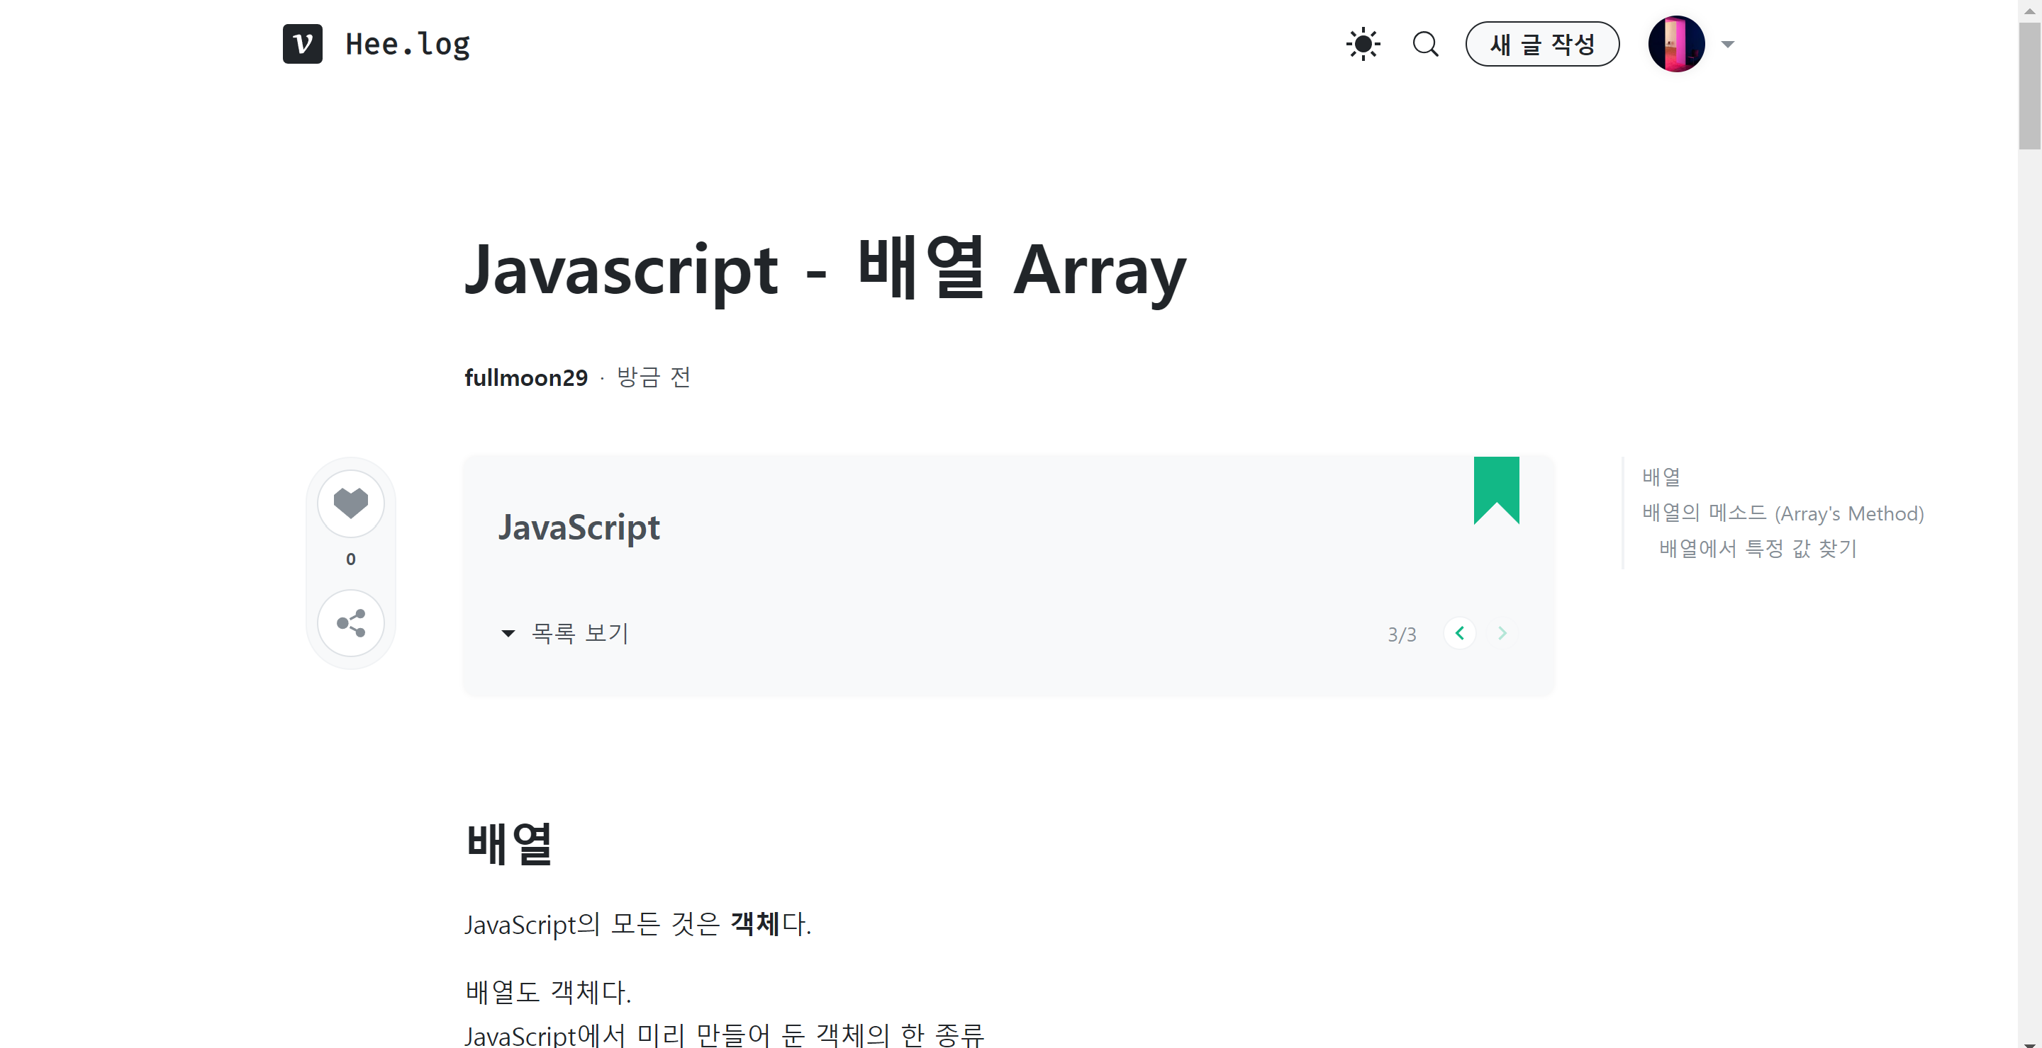
LOGO
user1

Slide 3
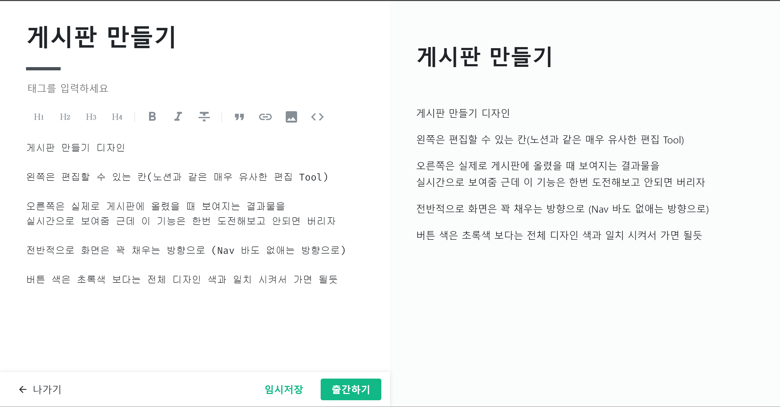
LOGO
user1
user1

